Slide 1
Introduction to Data Warehousing
By
Nilesh Sagale
02-Feb-2005

Slide 2
Burning questions???
What is a data warehouse?
What are the benefits of data warehousing?
How a data warehouse differs from normal database which I studied in university?
What are the commonly used terms in DWH arena?
What is the architecture involved?
How do I design a data warehouse?
What are the tools available in the market to build a DWH?
Which books and websites should I refer for further study?

Slide 3
What is a data warehouse?
Evolution and Definitions
First Question?

Slide 4
Evolution of DWH
Traditional approaches to computer system design
  Designed for data entry usage
  Archive the data
  Hardware was costly
  Single location and single product companies
Changes after 1980
  Need for analysis of historical data
  Hardware prices going southward
  Multi-location, multi-product companies
        (Contd.)

Slide 5
Evolution of DWH
‘Warehousing’ data outside the operational systems
Integrating data from more than one operational systems
Clear identification of transaction and analysis processes
  Two terms were coined in the industry, OLTP and OLAP

Slide 6
Definition of data warehouse
Ralph Kimball - states that a data warehouse is "a copy of transaction data specifically structured for query and analysis".
William (Bill) Inmon – states that data warehouse is a collection of data which is,
  Subject Oriented
  Integrated
  Non volatile
  Time Variant
      (Contd.)

Slide 7
Definition of data warehouse
Subject Oriented – Eg to learn more about sales data. Using sales data warehouse, you can answer questions like, ‘Who was our best customer for this item last year?’
Integrated – Data warehouse must put data from different sources into a consistent format
Non volatile – Once entered into data warehouse, data should not change
Time Variant – In order to discover trends in business, analysts need large amount of data.

Slide 8
What are the benefits of data warehousing?
Benefits and Disadvantages
Second Question?

Slide 9
Benefits of data warehousing
Freeing servers/disks used for transaction processing from querying
Speed up the querying and reporting time
Provide an environment where small or no technical aspects of database is required
Store data from multiple OLTP systems
Repository of data held over longer time span
Prevent persons who only need to query and reporting of data, from having access to transaction processing system database

Slide 10
Disadvantages of data warehousing
Stores historical data generated from internal transaction processing system. Business people need to consider lot of external factors while making decisions.
Small organisations (single location, single product) may not derive significant value from additional investments.
Data warehousing has a long learning curve because of iterative approach.
Limited number of people having ‘full life cycle’ experience
Needs great deal of ‘maintenance’
Business users may still want paper based reports

Slide 11
How a DWH differs from ‘normal’ database?
Contrast between OLTP and DWH
Third Question?

Slide 12
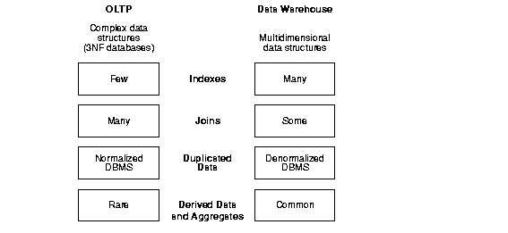
Contrasting OLTP and DWH

Slide 13
Contrasting OLTP and DWH
Workload –
  DWH designed to accommodate ad-hoc queries. You may not know the workload in advance.
  OLTP system supports only predefined operations. (Eg- Reception counter at hotel)
Data Modifications –
  DWH is updated on a regular basis (nightly, weekly or monthly) by a process. End users do not update the data. Data held is a snapshot of business.
  In OLTP systems, end users can update the database. OLTP database is up to date and reflects current status of business.
    (Contd.)

Slide 14
Contrasting OLTP and DWH
Schema design –
  DWH uses de-normalisation technique to improve the query performance
  OLTP systems use normalisation technique to improve update/insert/delete transactions and to guarantee data consistency.
Typical Operations –
  DWH – typical query will scan thousands or millions of rows.
    Eg – ‘Find total sales for all customers last month?’
  OLTP – accesses only handful of records.
    Eg – ‘Retrieve the current order for this customer’.
    (Contd.)

Slide 15
Contrasting OLTP and DWH
Historical data –
  DWH usually stores many months or years of data
  OLTP systems usually store data from only few weeks to months.

Slide 16
What are the commonly used terms in DWH arena?
Few terms
Fourth Question?

Slide 17
DWH Vocabulary
OLTP
OLAP
  MOLAP (Multi dimensional)
  ROLAP (Relational)
  DOLAP (Desktop/Distributed)
  HOLAP (Hybrid)
ETL
Data Mart/Data Warehouse
Facts
Grain (Granularity – lowest level of facts – monthly sales, daily sales)
Dimensions
Metadata
DSS
BI

Slide 18
What is the architecture involved ?
Fifth Question?

Slide 19
DWH Architectures
Data warehouses and their architectures vary depending upon the specifics of an organization's situation. Three common architectures are:
DWH Architecture (Basic)
DWH Architecture (With a staging area)
DWH Architecture (With a staging area and data marts)
        (Contd.)

Slide 20
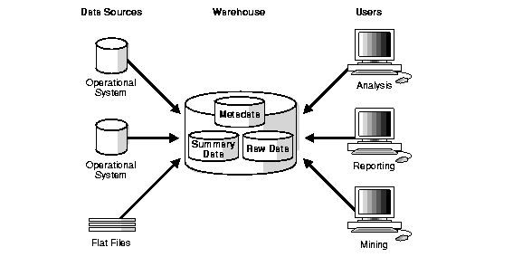
DWH Architecture (Basic)

Slide 21
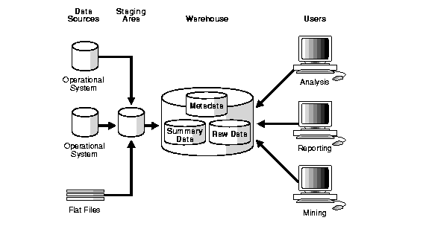
DWH Architecture (with a staging area)

Slide 22
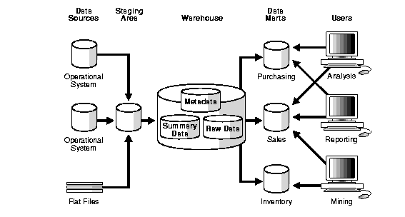
DWH Architecture (with a staging area and data marts)

Slide 23
How do I design a DWH ?
Sixth Question?

Slide 24
Design in DWH
Logical Vs Physical design -
  In logical design, you look at logical relationships among the objects (i.e. tables)
  In physical design, you look at most effective way of storing and retrieving the objects on disk from transportation and backup/recovery perspective.
(Contd.)

Slide 25
Logical Design in DWH
Creating a logical design –
  ER modelling involves identifying things of importance (entities), the properties of these things (attributes) and how they are related to one another (relationships).
  In RDBMS, an entity often maps to a table. Attribute often maps to a column.
  You can use, oracle designer or ERWIN for modelling (Contd.)

Slide 26
DWH Schemas
Schema is a collection of database objects, such as tables, views, indexes etc.
Star schema – Simplest, dimensional
Snowflake schema – flavour of normalisation
        (Contd.)

Slide 27
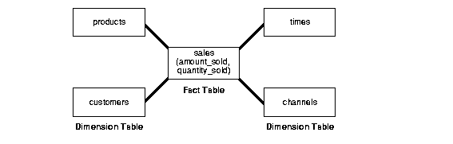
Star Schema

Slide 28
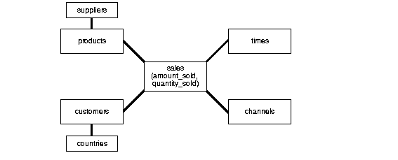
Snowflake Schema

Slide 29
DWH Objects
Fact tables – contains numeric facts and foreign keys to dimension tables
Dimension tables – attributes, commonly used dimensions are customers, products and time.
  Dimensions are usually arranged in hierarchical structure.
        (Contd.)

Slide 30
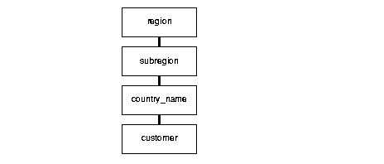
DWH Objects
Typical dimensional hierarchy

Slide 31
What are the tools available in market to build a DWH?
List of tools
Seventh Question?

Slide 32
Tools in the market
Extraction Transformation and Loading (ETL) tools
  like Informatica, Datastage, Datajunction, DataMirror,Trillium, DataFlux, ETI Extract, SAS Warehouse Administrator
Databases
  like Oracle, MS SQL Server 2000, Sybase, DB2, Informix, Redbrick, Teradata

Slide 33
Tools in the market
Business Intelligence tools
  ranging from OLAP tools like MicroStrategy, Brio, Business Objects, Cognos, Hyperion, Information Advantage, Informix Metacube, Webfocus, Hummingbird BI Suite
End to end tools
  such as SAS solutions, SAP Business Warehouse suite and Oracle Data Warehousing product suite.

Slide 34
Which books and websites for further study ?
List of books and websites
Eighth Question?

Slide 35
List of Books
‘Building the Data warehouse’ – W.H. Inmon
‘The Data Warehouse Toolkit’ – Ralph Kimball
‘Data Warehouse from Architecture to Implementation’ – Barry Devlin
If you use Oracle, ‘Oracle 8i Data Warehousing’ – Gary Dodge

Slide 36
List of Websites
Data Warehouse Institute
  http://www.tdwi.org/index.aspx
DW Review Magazine’s website
  http://www.dmreview.com/index.cfm
Kimball University
  www.kimballgroup.com
If you use oracle, then
  http://www.oracle.com/solutions/business_intelligence/index.html

Slide 37
Thank You !!!

